Slide 1
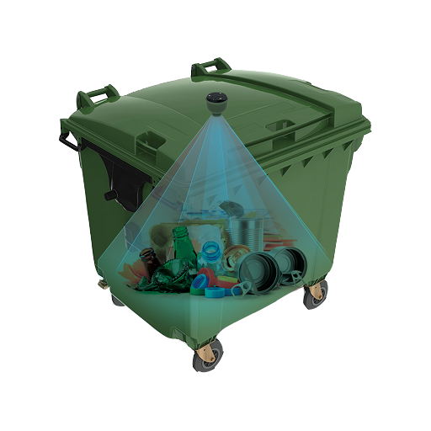
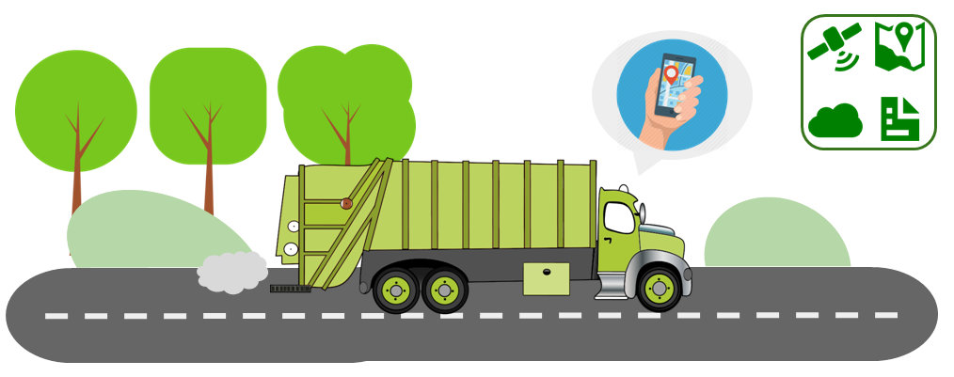
Smart Garbage Management System
Team IoCare
Rajendra Khope
Sarika Khope
Santosh Pandey
Varun Taware

Slide 2
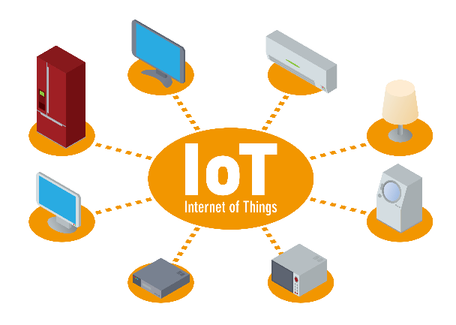
THEME
IoT – Internet of Things
The Internet of Things (IoT) is a system of interrelated computing devices, mechanical and digital machines, objects, animals or people that are provided with unique identifiers and the ability to transfer data over a network without requiring human-to-human or human-to-computer interaction.

Slide 3

Garbage Management and Collection in Cities, Town and Villages is a major concern and emerging problem in Smart City paradigm. Also lack of proper resource distribution in the process of Garbage collection is great risk to sanitation, cleanliness and health.
PROBLEM STATEMENT

Slide 4
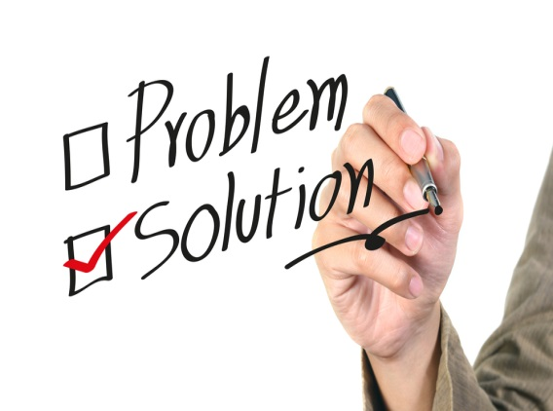
We propose a smart Wireless Garbage Bin equipped with LoRa RF and IoT technologies to solve this emerging issue in City/Town sanitation sector. Each Garbage Bin will be equipped with level and weight sensor along with GPS position information in case of any mobility. All data will be sent through LoRa/RF communication "Smart Mesh" link to central server where it can be made available through mobile app to Sanitation workers for quick response and effective collection and disposal of garbage. Efficient route calculation for garbage collector van is also proposed for minimizing the efforts in collection.
PROPOSED SOLUTION

Slide 5
1.LoRa:- It stands for Long Range and it is a technology that uses unlicensed spectrum below 1GHz along with a form of direct sequence spectrum modulation that provides signal detection below the noise level. 2.Smart Mesh:- Smart Mesh Networking is the first Wi-Fi meshing approach that combines high-gain smart antenna arrays, sophisticated RF routing, and centralized management in a single WLAN system. And it extends Smart Wi-Fi technology to create a new class of reliable WLANs that are self-organizing, self-optimizing, and self-healing. 3.RF:- RF is a Radio Frequency signal that refers to a wireless electromagnetic signal used as a form of communication. 4.WiFi:- Wi-Fi is the name of a popular wireless networking technology that uses radio waves to provide wireless high-speed Internet and network connections.
TECHNOLOGIES

Slide 6
1. Prevent overflowing of Garbage bins due to real-time status of bins on centralized system and mobile application. 2. More efficient garbage collection due to availability of empty bins as its collected in time. 3. Use of LoRa and smart Mesh RF technology prevent any use of infrastructure such as GSM/GPRS or Wi-Fi. 4. Recurring cost reduction as compare to many existing solutions which uses GSM based approach. 5. Shortest garbage collection route algorithm calculates best possible route for collection of garbage bins. 6. Area-wise SMS/Push messages delivered to Municipal Corporation workers to optimize the manpower and energy consumption. 7. Garbage Reward program to dispense reward/offer coupons to local public based on amount of waste deposited in one time.
BENEFITS

Slide 7
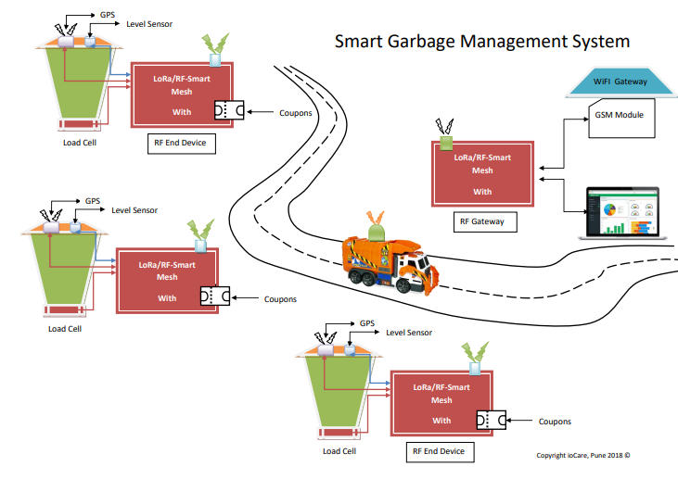
SYSTEM ARCHITECTURE

Slide 8
1.”Smart Garbage Management System” -ISSN No.:-2278-0182 , IJERT – Volume-4 -3 March, 2015 2.”Smart Bin Implementation for Smart Cities” -ISSN No.:-2229-5518 , IJSER – Volume-6 -9 September, 2015 3.”Automated Waste Management” -Patent Application Publication – US 2015/0307273AI -29 October, 2015 4.”IOT Based Smart Garbage and Waste Collection Bin” -ISSN No.:-2278-9098 , IJARECE – Volume-5 -5 May, 2016 5.”Smart Garbage Monitoring System for Waste Management” -MATEC Web of Conferences 97, 2016 6.”IOT Based Waste Management Using Smart Dustbin” -Reference No.:-40S-BE-2142
REFERENCES

Slide 9
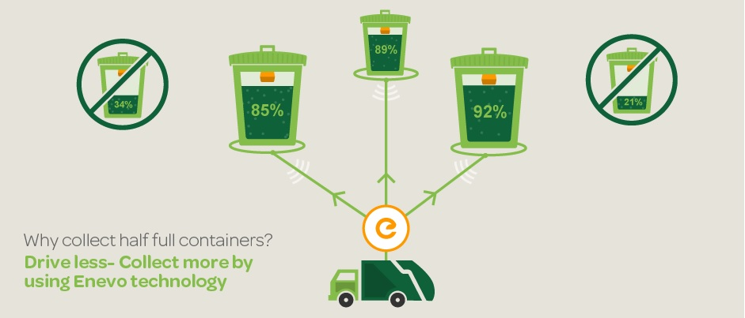
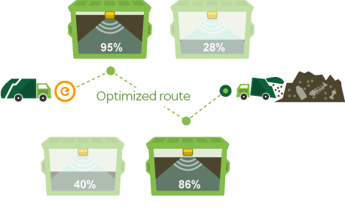
CONCLUSION
Monitoring the fullness of bins through the use of sensors, it is possible to achieve a more efficient system than the current existing. Our idea of “Smart waste management system”, mainly concentrates on Monitoring the waste management, providing a smart technology for waste system, avoiding human intervention, reducing human time and effort and which results in healthy and waste ridden environment.

